Slide 1

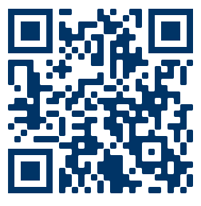

SIVA infographic competition: In it to win it
What?
A chance to win the
2023 SIVA ASM infographic competition
1st Prize is a copy of
TIVA & TCI - a comprehensive global anthology (Absalom & Mason)
Conference fees waived* for top 3 submissions.
(* for SAS doctors and trainees)
All TIVA related topics welcomed
Use of symbols, icons, diagrams encouraged
We are looking for snappy engaging 1 page summaries
When?
Submission deadline: Midnight 20th Oct 2023
Top 3 submissions invited to give a 3 minute (in person) presentation
at the SIVA ASM 16th-17th Nov 2023
1st prize awarded to the best combined infographic and presentation
Style Guide
Maximum: 1 page
Size: Width 25.4 cm height 19.05 cm
Orientation: portrait or landscape
File format: .PDF
Colour palette:
(additional colours
may be used)
Font: Avenir
For more information on how to create and submit an infographic please scan the QR.
Hex: 003466
Hex: 4C86AC
infographics - education with a big k_{e0}
Designed by: (maximum of 2 authors)
Insert your twitter handle (if appropriate): e.g. @SIVAtrainees

